Slide 1

Software Engineering Process

Slide 2

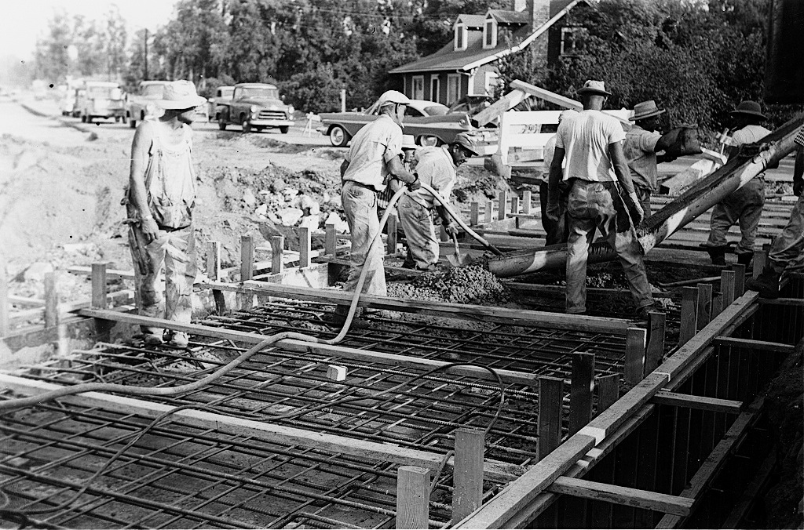
Engineering software is a big job
http://flic.kr/p/7GereG
http://flic.kr/p/5w9rXP
Variety of tasks:
Requirements
Design
Implementation
Verification (testing)
Maintenance

Slide 3
Who has heard of “Waterfall” and “Agile”?

Slide 4
Practical issue: What order should tasks be done in?
That is, what process to use?

Slide 5
The classic way: Waterfall (sequential) model
Requirements
But often a bad way…
Design
Implementation
Verification
Maintenance
http://en.wikipedia.org/wiki/File:Waterfall_model_%281%29.svg
Notes:
60s and 70s-era advice

Slide 6
What could go wrong?
Requirements
6 months
Design
6 months
Implementation
3 months
Verification
6 months
Release!
http://en.wikipedia.org/wiki/File:Waterfall_model_%281%29.svg
Notes:
60s and 70s-era advice

Slide 7
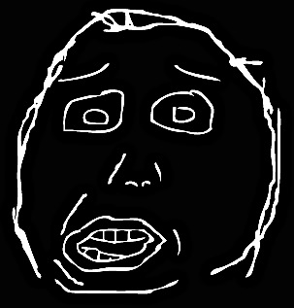
What could go wrong?
Problem!
Requirements
6 months
Design
6 months
Implementation
I don’t like it…
3 months
Verification
6 months
Release!
Customer
http://en.wikipedia.org/wiki/File:Waterfall_model_%281%29.svg
Notes:
60s and 70s-era advice

Slide 8
Waterfall is often a poor practice
High failure rates
Low productivity
High defect rates
45% of features in requirements never used
Early schedule and estimates off by up to 400%

Slide 9
Why Waterfall doesn’t work
False assumption: Specifications …
are predictable and stable
can be correctly defined at the start
have low change rates
Actual stats:
25% of requirements changed
35% to 50% changed in large projects

Slide 10
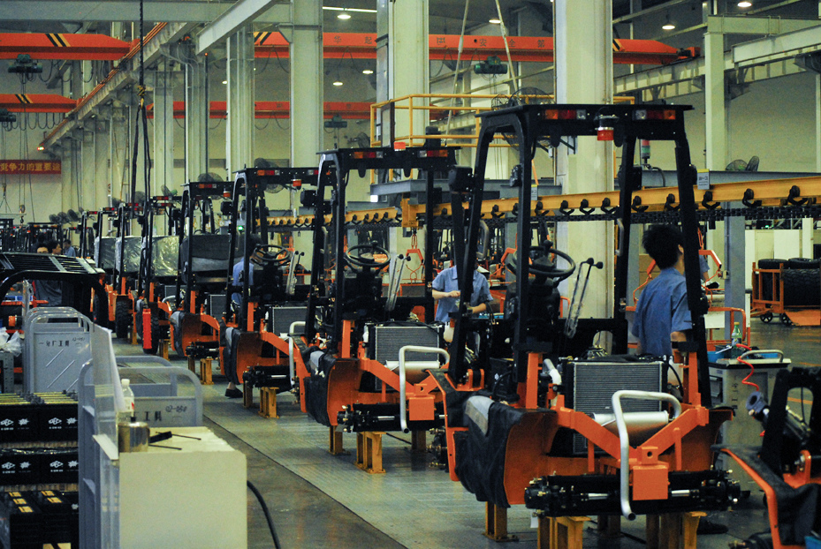
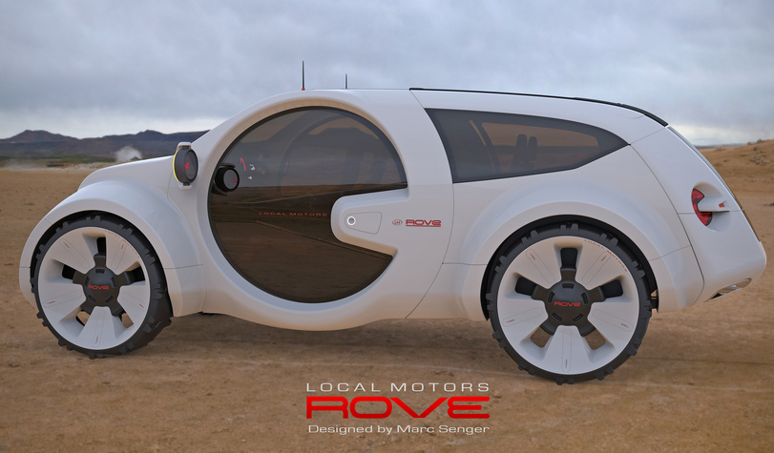
What is software engineering more like?
web app
web app
web app
web app
Mass manufacturing?
http://flic.kr/p/9xmccb
web app
New product development?
http://flic.kr/p/edV9JR
Notes:
Each machine that comes off the assembly line is like a piece of software. This is obviously a false analogy.

Slide 11
Waterfall is a “defined” process control model
(good for mass manufacturing)
http://flic.kr/p/9xmccb
Software devel. needs an “empirical” model
(good for new product development)
http://flic.kr/p/edV9JR
Notes:
Each machine that comes off the assembly line is like a piece of software. This is obviously a false analogy.

Slide 12
Basis of empirical process model…
Feedback
Adaptation

Slide 13
Iterative Development Process
Requirements
Analysis
Design
Initial Planning
Planning
Implementation
Testing
Evaluation
Deployment

Slide 14
Iterative Development Process
Requirements
Analysis
Design
Initial Planning
Planning
Implementation
Where are
feedback
&
adaptation?
Testing
Evaluation
Deployment

Slide 15
Iterative Development Process
Requirements
Analysis
Design
Initial Planning
Planning
Implementation
Adaptation
Feedback
Testing
Evaluation
Deployment

Slide 16
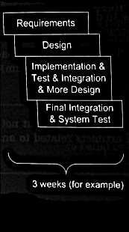
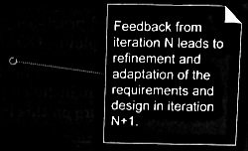
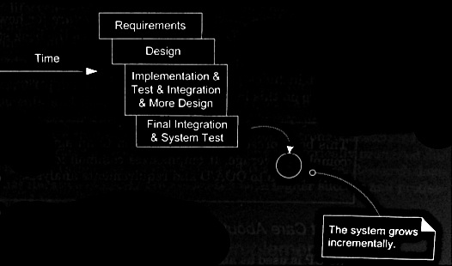
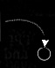
Iterative and incremental development
also called iterative and evolutionary
Larman Figure 2.1

Slide 17
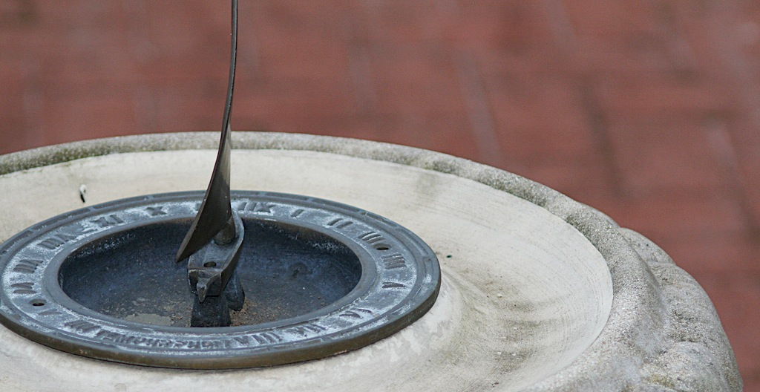
How long should iterations be?
Short is good
2 to 6 weeks
1 is too short to get meaningful feedback
Long iterations subvert the core motivation
http://flic.kr/p/368zW7

Slide 18
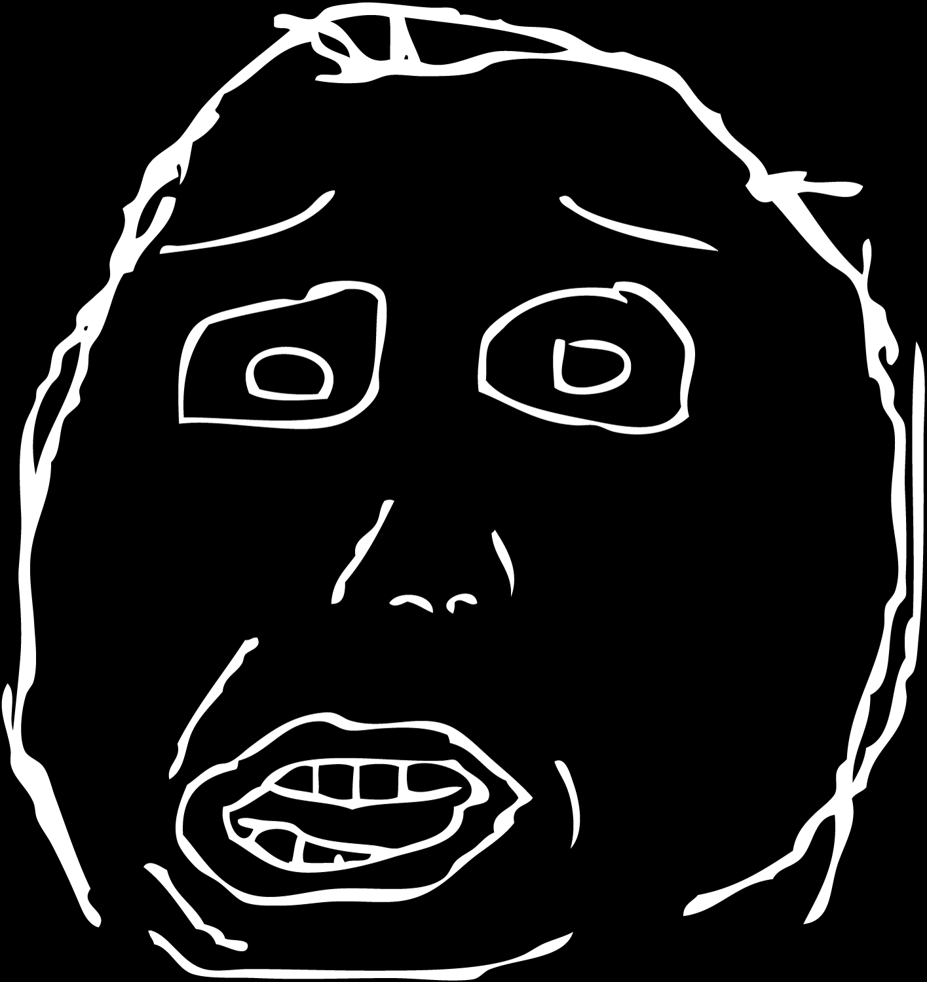
Iterative and incremental development addresses the “yes…but” problem
Yes, that’s what I asked for, but now that I try it, what I really need is something slightly different.

Slide 19
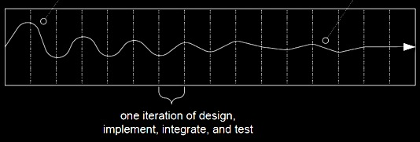
System converges over time
Unstable requirements
Requirements more stable
Larman Figure 2.2

Slide 20
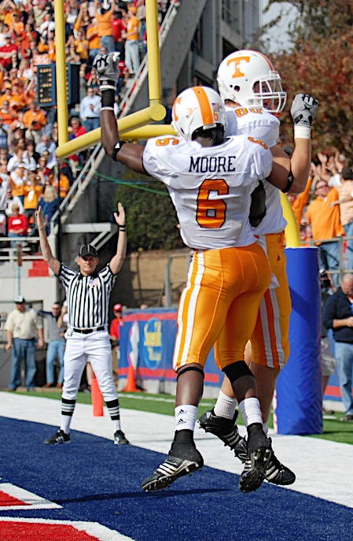
More benefits of iterative development
Fewer defects
Greater productivity
Early mitigation of risk
Early visible progress
Meet real needs of stakeholders
No “analysis paralysis”
Iterative process improvement
http://flic.kr/p/7fD777

Slide 21
Iterative and incremental development
Agile Development
Unified Process
Kanban
Lean
Crystal Clear
Extreme Programming
Scrum
Rapid Application Development
Test Driven Development
Model Driven Engineering
Notes:
Warn about ”branding” and every company having the best flavor of Agile

Slide 22
Clarification about terms
Often Agile and Scrum are used interchangeably
Agile is a set of 12 principles
E.g., Working software is the primary measure of progress
Agile is very broadly defined
Many, many different interpretations

Slide 23
High-level values of Agile
Individuals and interactions over processes and tools
Working software over comprehensive documentation
Customer collaboration over contract negotiation
Responding to change over following a plan
http://agilemanifesto.org/

Slide 24
High-level values of Agile
Iterations
Customer feedback
Deliver software frequently
Face-to-face communication
Daily cooperation between everyone
Reflect on team efficiency

Slide 25
Agile principles
Note: I wouldn’t say all of these are equally useful…

Slide 26
Agile principles
1. Customer satisfaction by early and continuous delivery of valuable software.
2. Welcome changing requirements, even in late development.
3. Deliver working software frequently (weeks rather than months)
4. Close, daily cooperation between business people and developers

Slide 27
Agile principles
5. Projects are built around motivated individuals, who should be trusted
6. Face-to-face conversation is the best form of communication (co-location)
7. Working software is the primary measure of progress
8. Sustainable development, able to maintain a constant pace
COVID anyone?

Slide 28
Agile principles
9. Continuous attention to technical excellence and good design
10. Simplicity—the art of maximizing the amount of work not done—is essential
11. Best architectures, requirements, and designs emerge from self-organizing teams
12. Regularly, the team reflects on how to become more effective, and adjusts accordingly

Slide 29
How to implement these principles?

Slide 30
Stand-up meetings
Daily team meeting
Uncomfortable! Stand!
Fast and to the point
Everyone talks:
What I did yesterday
What I will work on today
What I am blocked on

Slide 31
Kanban board
To Do
In Progress
Done

Slide 32
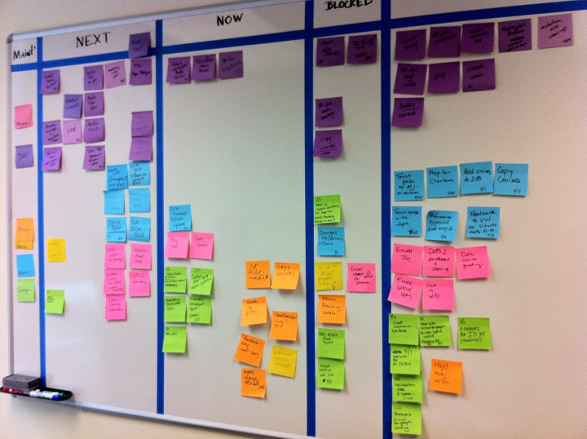
Kanban board

Slide 33
Kanban board
Items can be added and moved at any time
Very useful for tracking progress
Quick glance to see everyone’s status and progress
Popular at companies
I used it at National Instruments and Microsoft
Gamification: who can complete the most?!

Slide 34
Pair programming
Two programmers work together at one computer
Driver: keyboard and mouse
Navigator: observes and provides feedback
After some amount of time, switch!

Slide 35
Pair programming
Two heads are better than one
Reduces communication latency
What if one person is “better” or more experienced?
Expert gets a sounding board and checker
Novice gets to see how expert works
In practice, it is used sparingly
E.g., working on a tough problem
Expensive
Stressful

Slide 36
Refactoring

Slide 37
Refactoring
Restructure code without changing behavior
Why??
Maintainability: easier to read and change
Extensibility: easier to extend
Example:
Break a function up into two functions
Reorganize code to be in classes

Slide 38
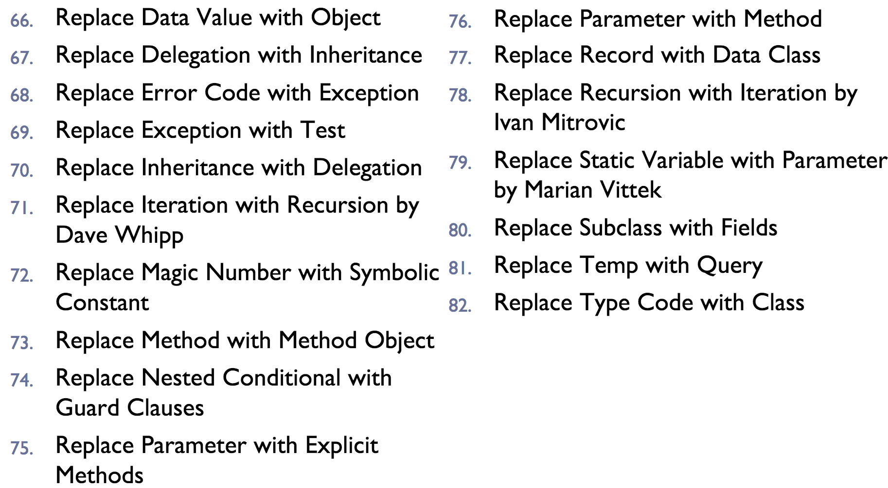
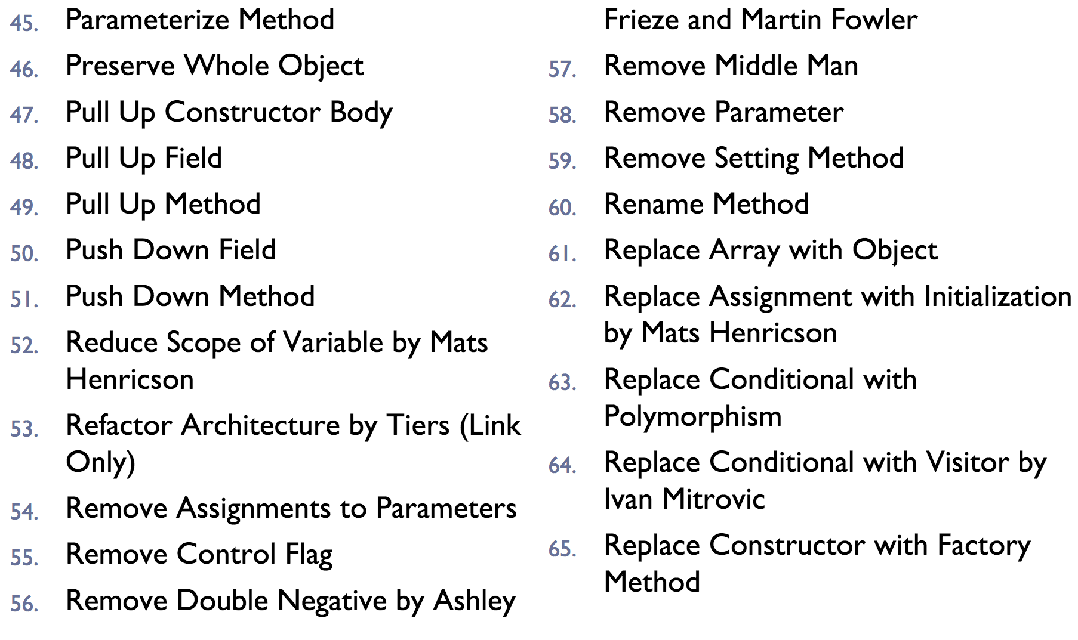
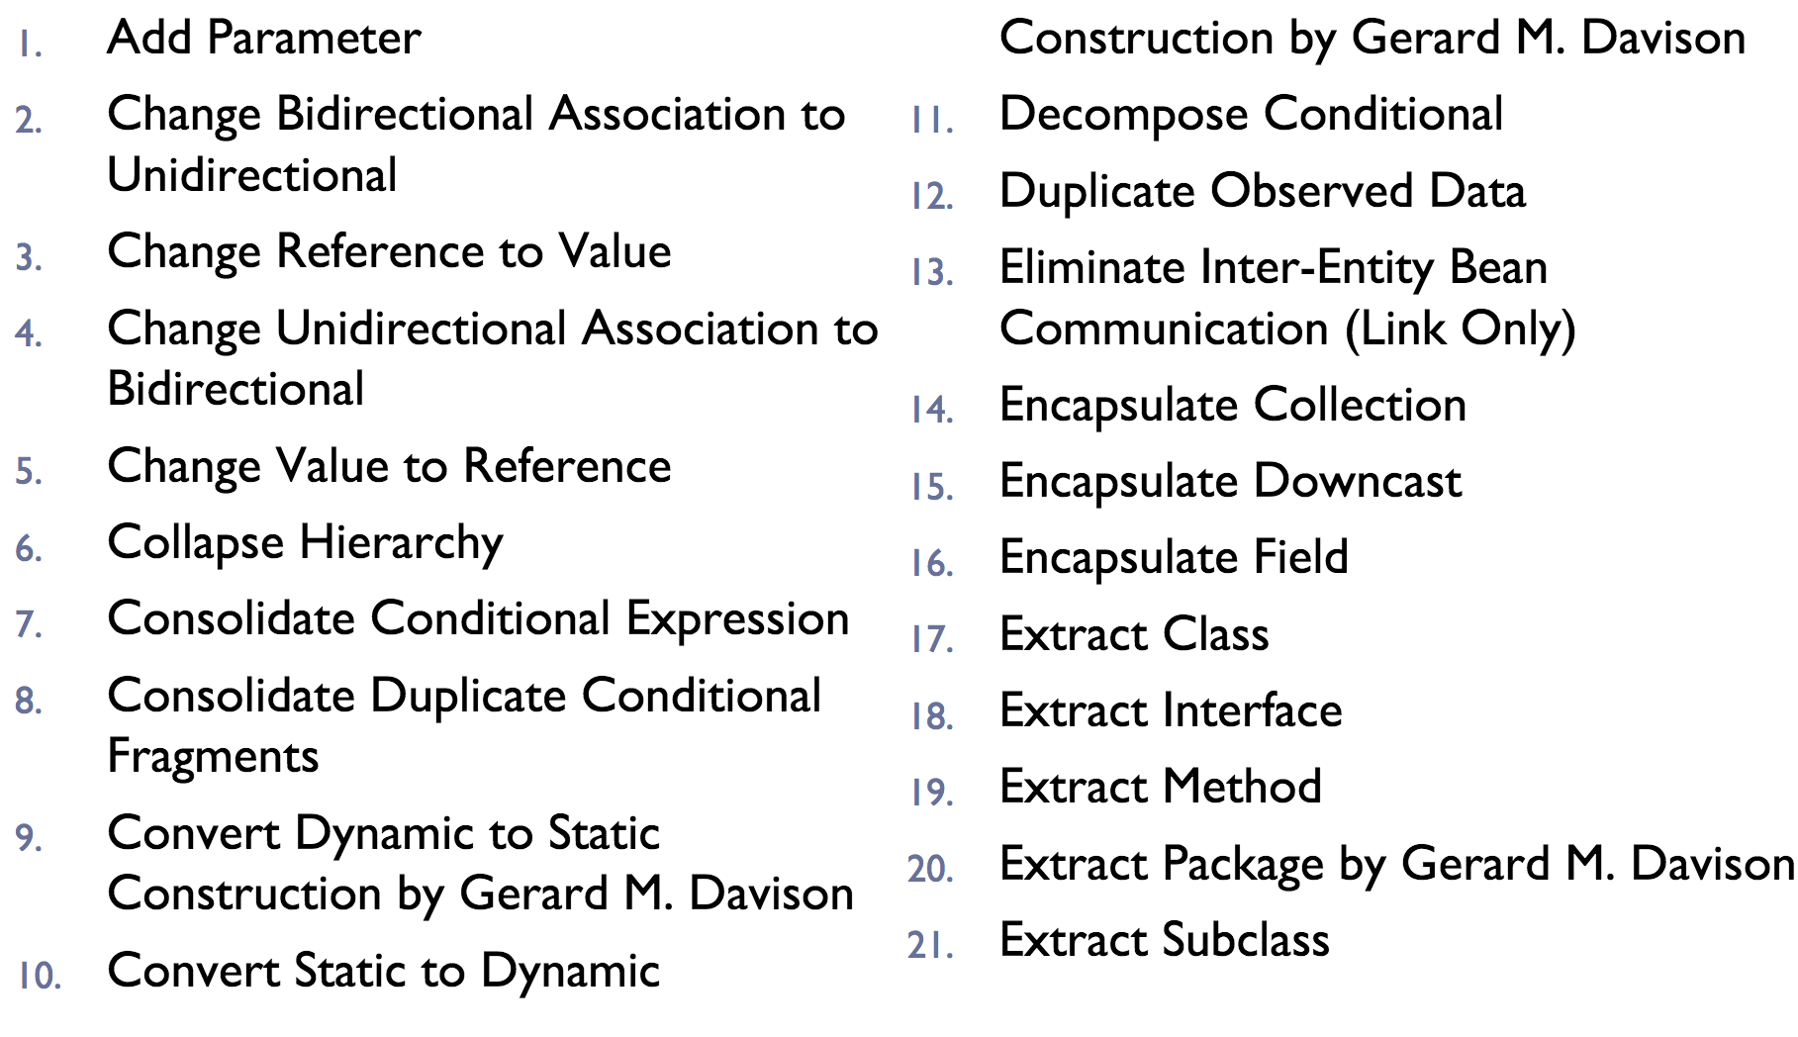
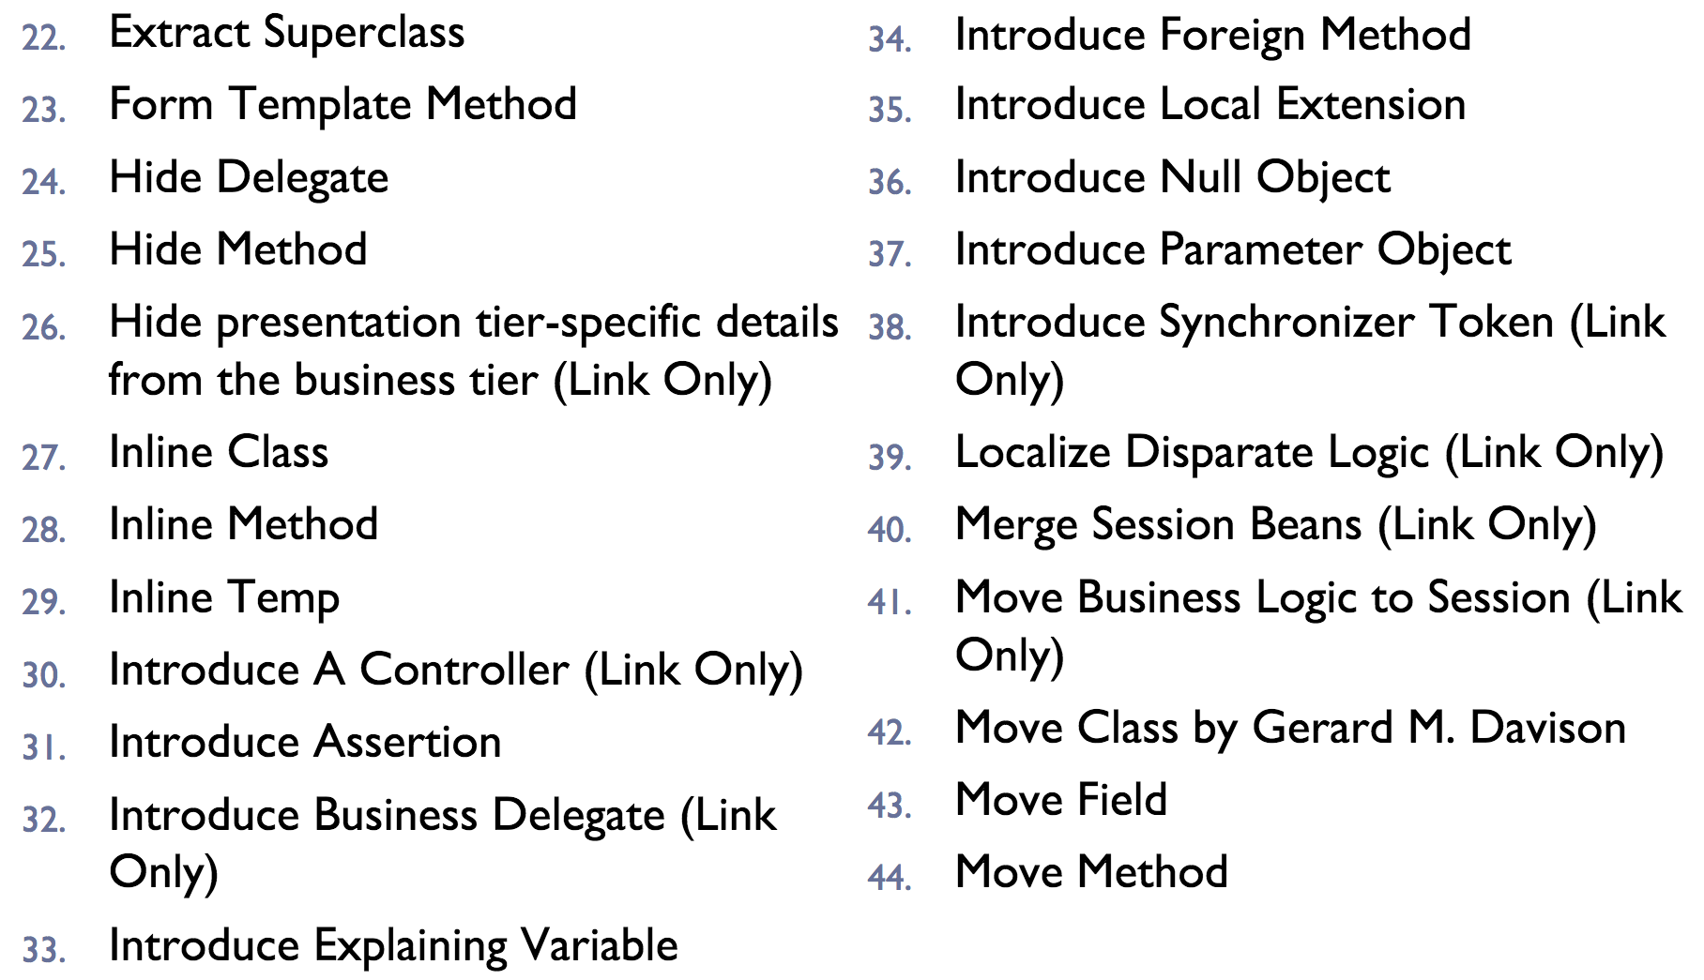
Refactoring

Slide 39
Refactoring

Slide 40
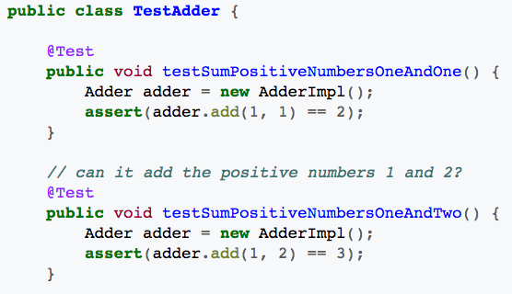
Unit Tests
Write code that tests your code
Ensure correct behavior
Identify changes that change behavior

Slide 41
Test Driven Development
Write tests
Write code
Refactor
”red, green, refactor”
Write tests that fail
Write code that passes tests
Refactor to make the code better

Slide 42
And many more…
User stories
Code reviewing
Continuous integration
Timeboxing
Planning poker

Slide 43

Summary
Software Engineering Process
Waterfall
Iterative and Incremental
Agile activities
http://flic.kr/p/aCLor3

